Slide 1
North Tonawanda High School
Academy of information technology
AOIT Director – Ms. Sattelberg

Slide 2
Did you know…
71% of all new jobs in STEM are in computing.
There will be over 1 million computing job openings in the U.S. by 2022.
There is an annual shortage of over 100,000 skilled computer specialists this year – over 39,000 of which are in New York State.
These jobs are in every industry and every state.
Computing skills and knowing how to code is a game changer for students.
The AOIT offers STEM and STEAM learning experiences.
Our students need to go beyond being consumers of technology and become innovators of technology.
Data Sources:
Code.org Infographic Source Data
www.bls.gov

Slide 3
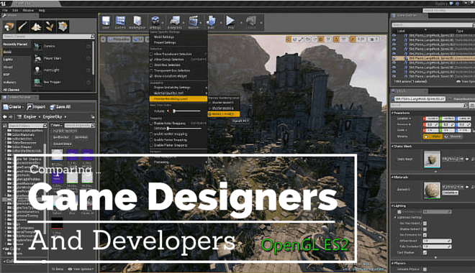
The technical Side of Computing
Those who design and maintain the technology that every industry relies on.

Slide 4
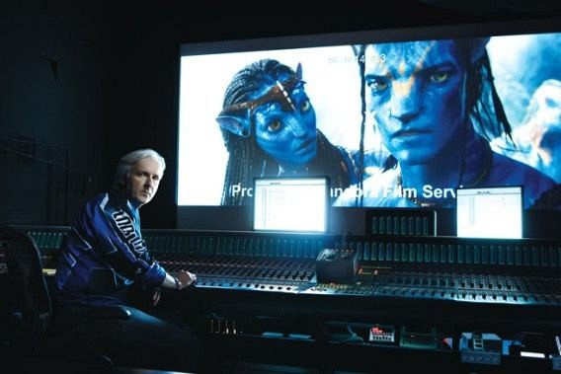
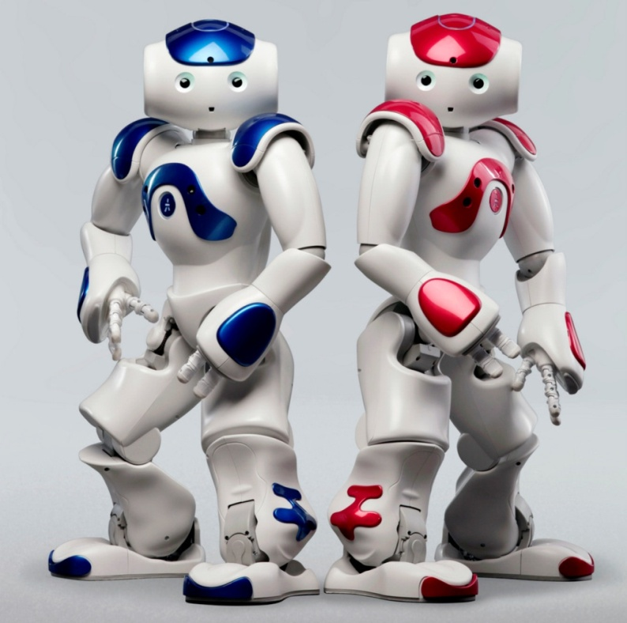
Coding
is an essential
skill in the
21st century
workplace.

Slide 5
The technical Side of Computing
Computer programmer
Cyber security
Computer repair
Game design
Robotics
Cellular
Government
Software Development
Software Engineering
Hardware Engineering
Database Administration
App Development
Network Administration
Web Development
Computer Systems Analyst

Slide 6
The Creative Side of Computing
Those who use technology to create products and services.

Slide 7
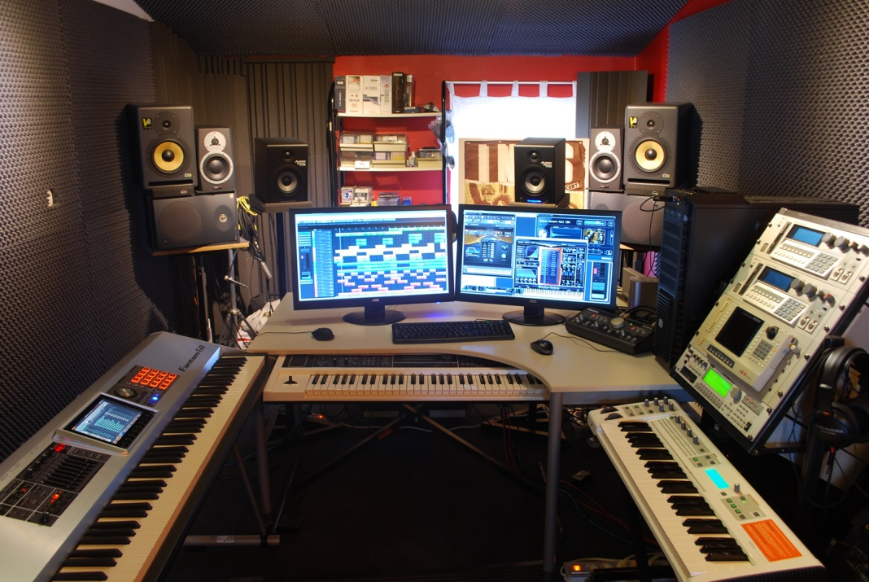
Creativity
+ problem solving = INNOVATION

Slide 8
The Creative Side of Computing
Game Design
Animation
Graphic Design
Film Media/Production
Web Design
Marketing
Publication Design
Broadcast
Apparel Design
Fashion Design
Advertisement Design
Social Media
Music Production
Concert/Theater Tech

Slide 9
Aoit courses.
Academy courses include a
blend of Art, technology, English,
business and computing.
Students typically have room in their schedules to take music, foreign language, and AP courses.

Slide 10
Aoit courses.
Grade 9
Principles of Information Technology (business)
Computer Systems (technology)
Grade 10
Digital Media (art)
Intro. To Programming (business)
Grade 11
Animation and Game Design (business)
CEIP (business)
Computer Applications (business)
Grade 12
Web Design (business)
AOIT Elective

Slide 11
Aoit Electives.
Many opportunities to get involved…
Tech Club
Science Olympiad
DECA
FBLA
Yearbook
Musical (tech support)
Competitive Events
Community Service
Digital Media Technology and Production
Web Design and Multimedia
Hospitality/Sports Marketing
Advanced Computer Science
AP Computer Science
Computer Networking
Animation and Game Design
Graphic Design

Slide 12
Projects,
Fields trips
And
Student experiences

Slide 13
Student Logo
Design Project

Slide 14
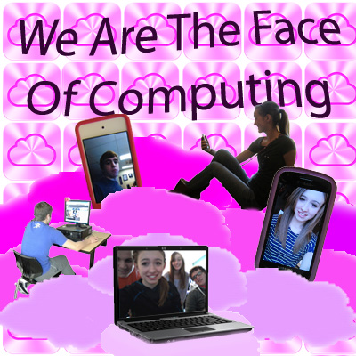
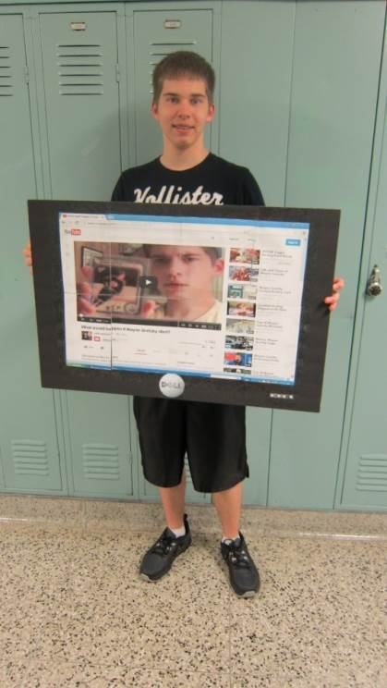
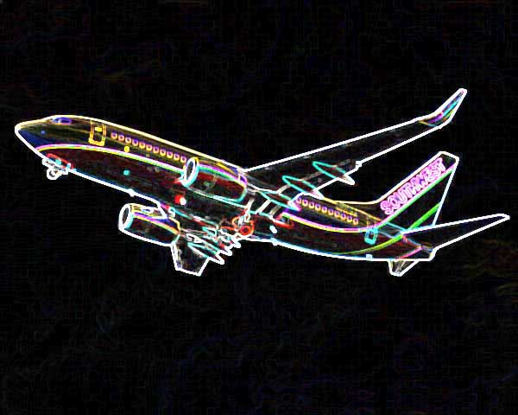
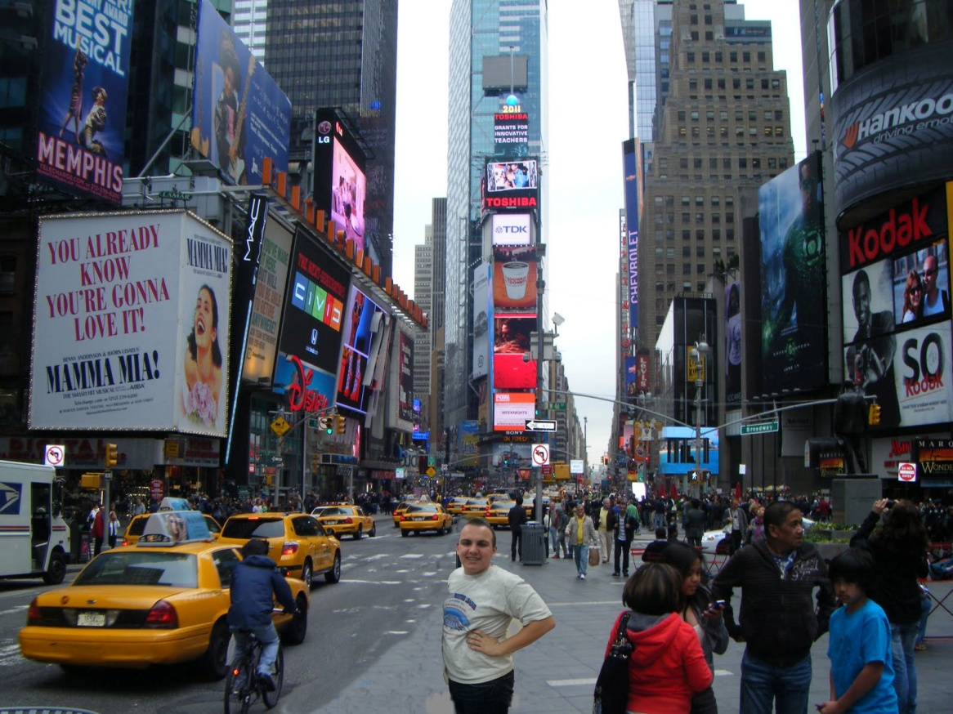
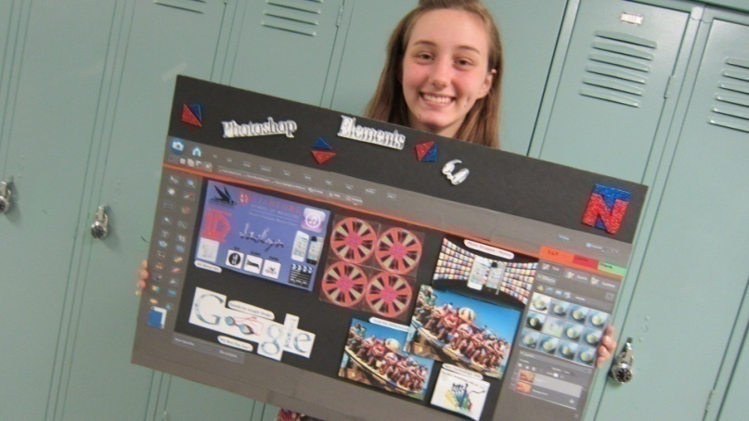
Student
Work

Slide 15
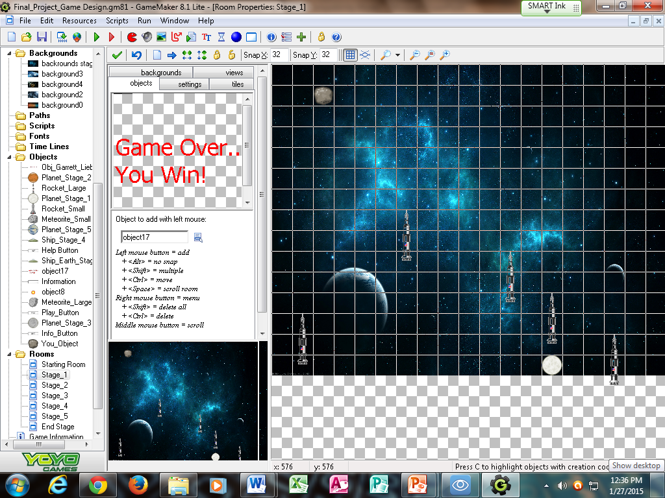
Game
Design

Slide 16
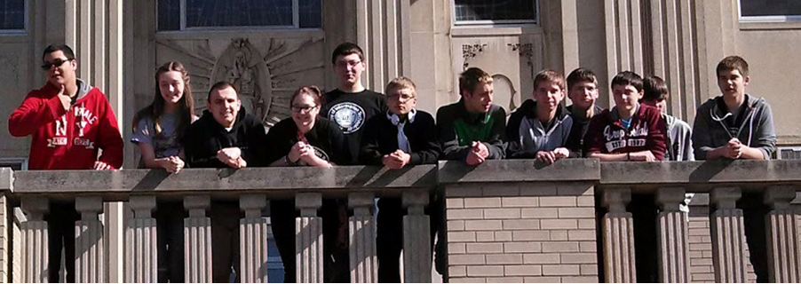
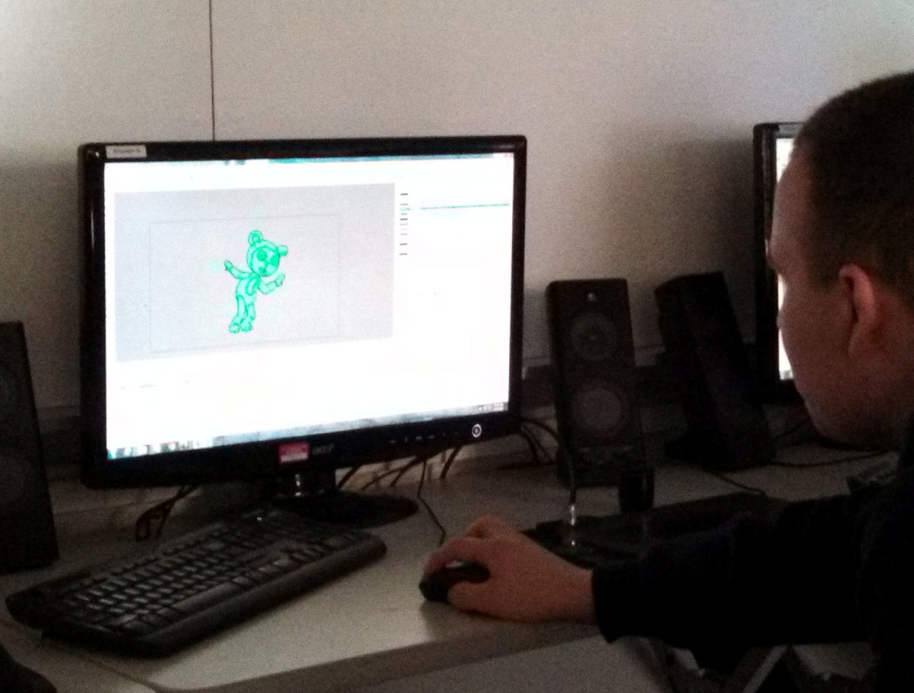
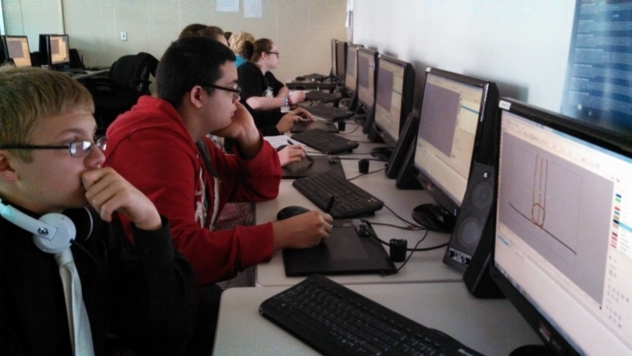
Animation Workshop at
villa Maria College

Slide 17
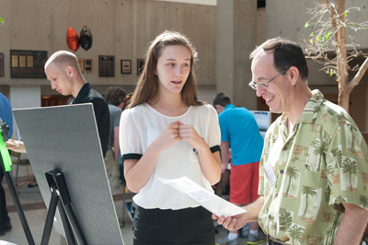
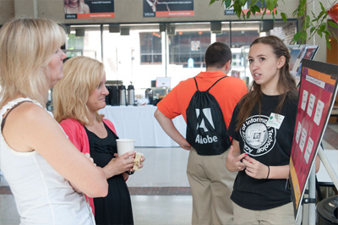
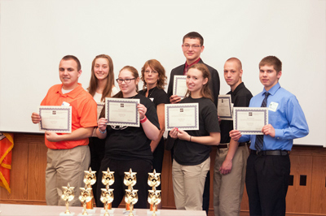
CS4HS Student Showcase and Competition

Slide 18
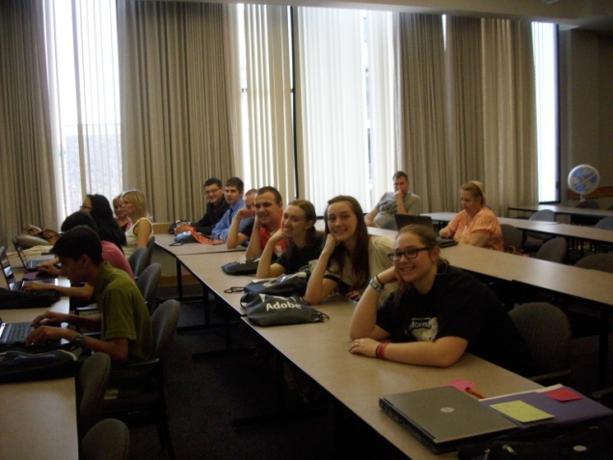
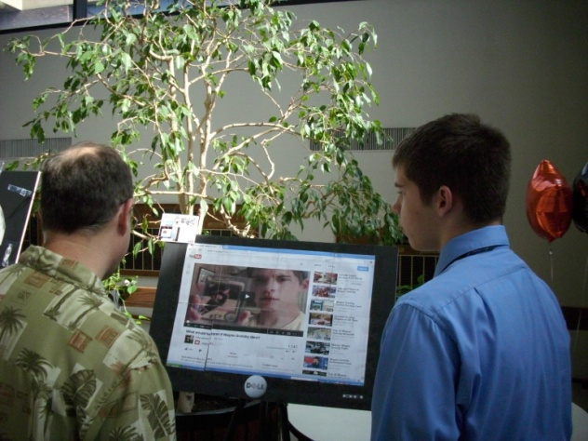
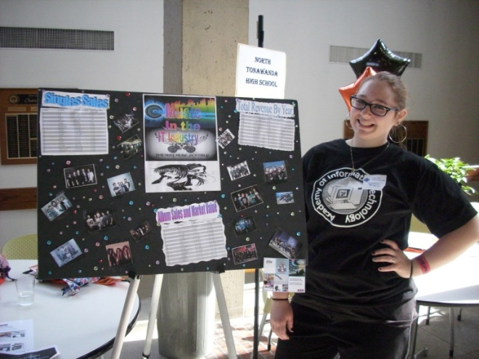
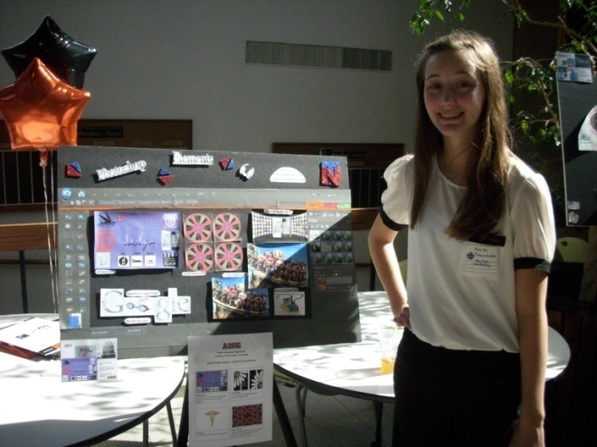
CS4HS Student Showcase and Competition

Slide 19
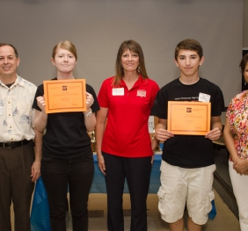
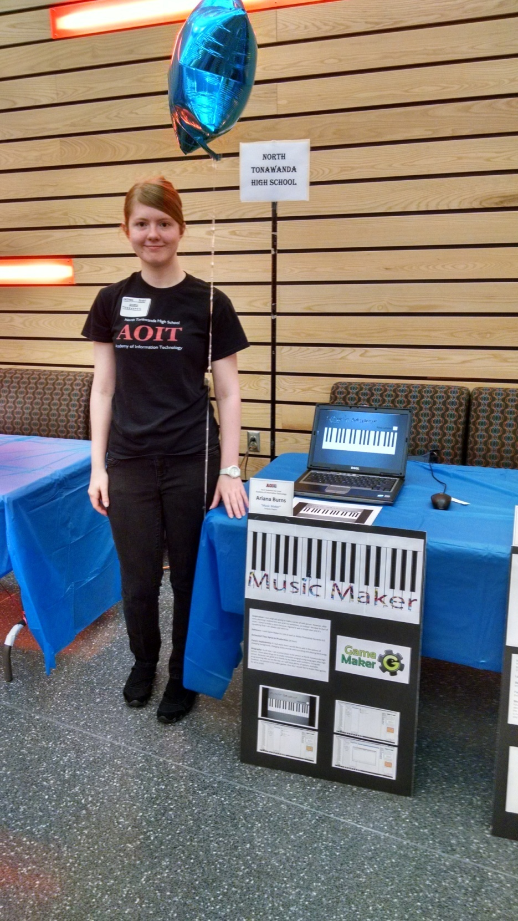
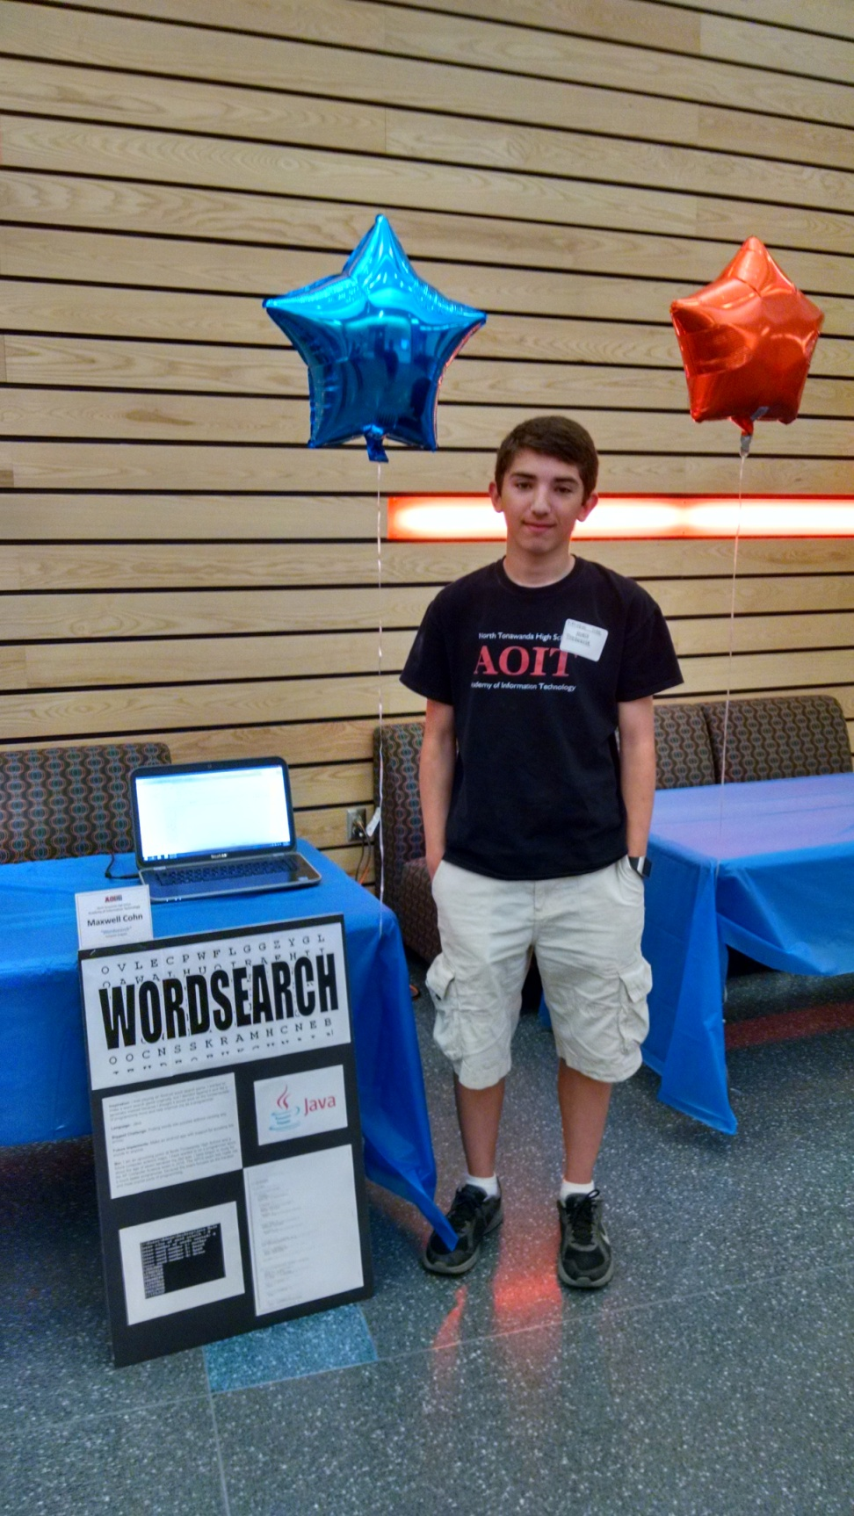
CS4HS Student Showcase and Competition

